Slide 1
Brazilian E-Commerce Dataset - Olist
Team 1 | Manish Oswal | Jesse Cajita | R. Sreenivasan | Christopher Tan | Christopher Choo

Slide 2
AGENDA
Problem Statements
Key Recommendations
Technical Overview
Delivery Performance
Customer Segmentation
Seller Score Card

Slide 3
PROBLEM STATEMENTS

Slide 4
OLIST NEEDS TO ANSWER 3 KEY PROBLEM STATEMENTS TO ENABLE ITS NEXT PHASE OF GROWTH…
How efficiently are orders being delivered?
Who are the most valuable customers?
Which sellers generate the most revenue and provide the best customer experience?
INSERT GRAPHIC OF A BRAZILIAN E-COMERCE COMPANY OLIST HERE

Slide 5
KEY RECOMMENDATIONS

Slide 6
1nsight’s KEY RECOMMENDATIONS CENTRE ON Customers, Sellers, and the Olist EXPERIENCE…
1. Customer Graphic
IMPROVING CUSTOMER SATISFACTION
DELIVERY PERFORMANCE
Improvements in Actual Delivery Time will result in improved Customer Review Scores that drive more repeat orders.
2. Seller Graphic
INCREASING SELLER REVENUE
CUSTOMER SEGMENTATION
Customers should be segmented by band (Gold / Silver / Bronze) for Olist to focus on customers in cities with higher total spend.
3. Platform Graphic
ENHANCING PLATFORM QUALITY
SELLER SCORE CARD
Sellers may be prioritized by Total Order Value and Average Review Score to increase the quality of Sellers on the Olist platform.
Notes:
We are tackling the problem (whatever it is) from 3 angles. The first is the actual performance of the platform, which we distil into Delivery Performance. And we need to improve the quality of the participants in this dual-sided platform, which comprises Customers and Sellers. Hence on the Customer side, we want to perform Customer Segmentation, and on the Seller Side, we want to develop a score card that allows us to prioritise them by Total Order Value and Average Review Scores.

Slide 7
TECHNICAL OVERVIEW

Slide 8
Technical Overview
The next 2-3 slides should include some info on: 1) Architecture
2) Database Warehouse Design (Star Schema and Dimension Tables)
3) ELT Pipeline
4) Data Quality Testing

Slide 9
BIGQuery and DBT Were used for the ELT process to provide a single source of truth for analytics…
ELT Pipeline
Olist CSV Files
Google BigQuery
DBT Transform
Analytics
Local Storage
Cloud Storage
Insights
Insert Fact and Dimension Tables Here
Google BigQuery was selected to allow data scientists who are working remotely to update, access, transform, and analyse data to deliver insights.
1nsight
KEY RECOMMENDATIONS
9

Slide 10
DELIVERY PERFORMANCE Improving Customer Satisfaction

Slide 11
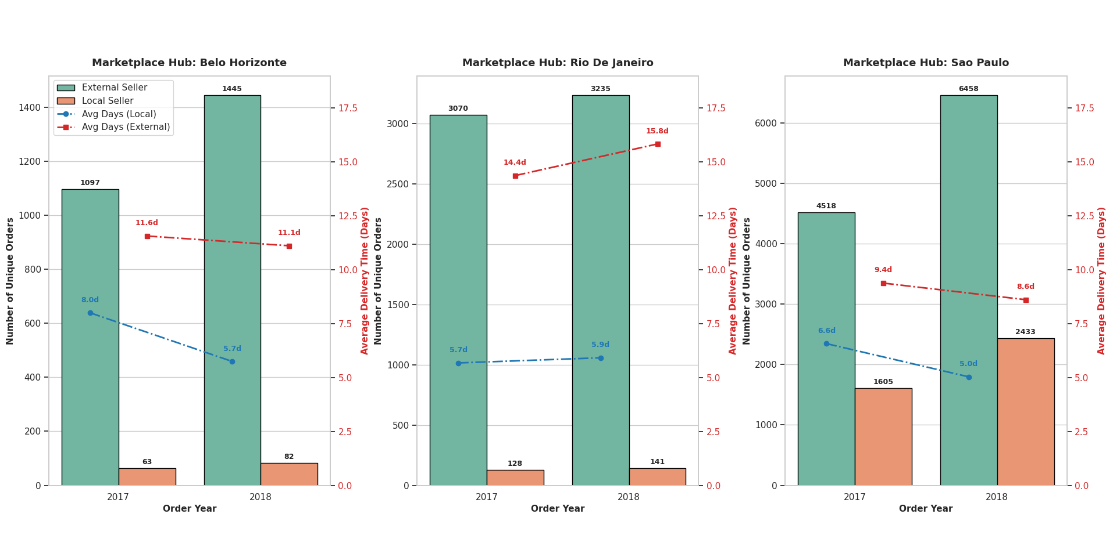
A majority of items sold are fulfilled by External Sellers Instead of local sellers…
The Average Delivery Time for orders is significantly longer when they are fulfilled by External Sellers. There is opportunity to reduce Delivery Times by bringing orders closer to the respective markets.
1nsight
DELIVERY PERFORMANCE
11

Slide 12
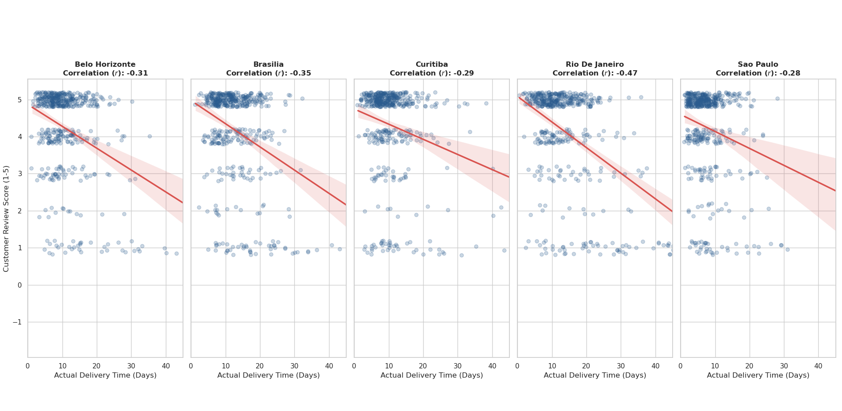
Customer Review Scores can be significantly improved by reducing Actual Delivery Times…
Customer Review Scores are negatively-correlated with the Actual Delivery Time, which varies from city to city. Rio De Janeiro is the most sensitive to reductions in Delivery Time, followed by Brasillia, Belo Horizonte, Curibata, and Sao Paulo.
1nsight
DELIVERY PERFORMANCE
12

Slide 13
Recommended Interventions
Use Gemini to generate some suggestions on interventions that can be made to significantly reduce actual delivery times by bringing Sellers closer to Buyers in each market.
1nsight
DELIVERY PERFORMANCE
13

Slide 14
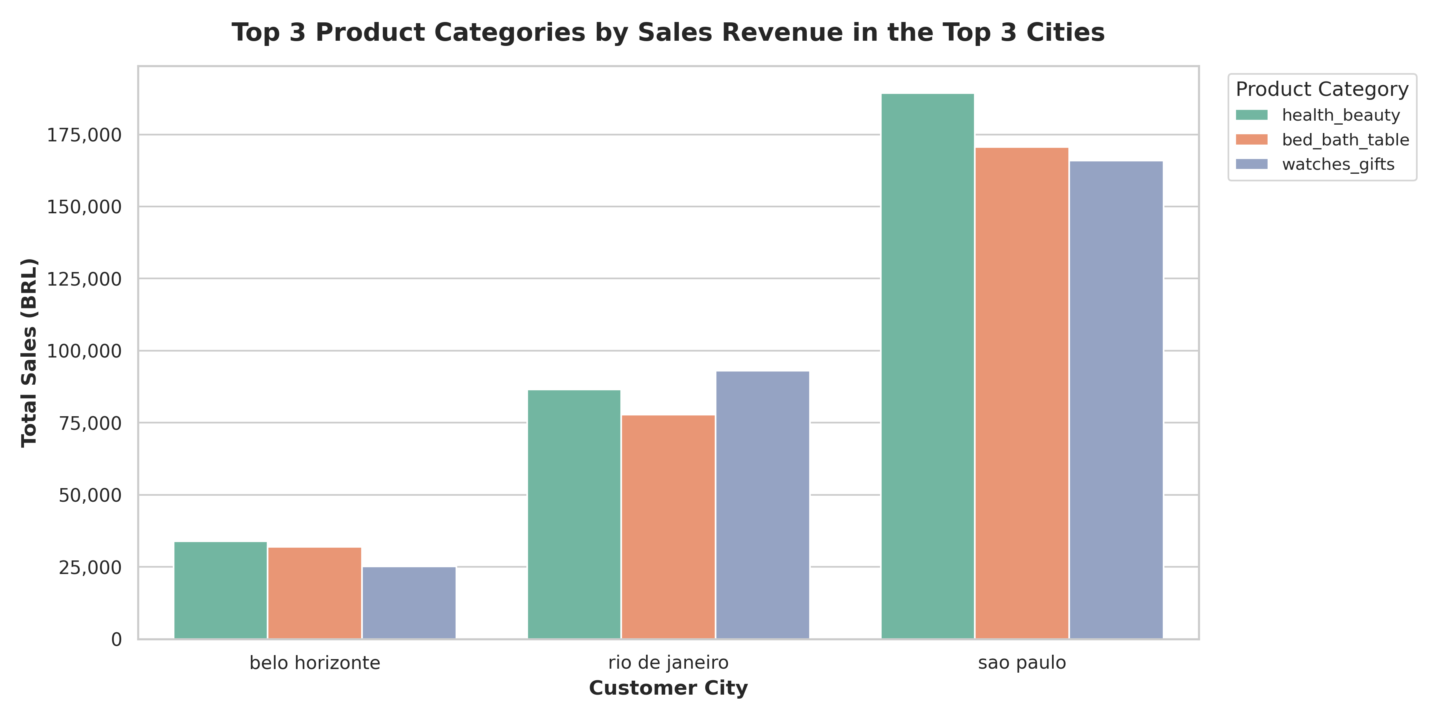
Delivery Time Improvements will be targeted at The top 3 products in sales Revenue for the Top 3 cities…
The product categories that had the highest sales in the top 3 cities were Health and Beauty, Bedroom and Bathroom Accessories, and Watches and Gifts (??)
1nsight
DELIVERY PERFORMANCE
14

Slide 15
CUSTOMER SEGMENTATION Increasing Seller Revenue

Slide 16
SLIDES ON CUSTOMER SEGMENTATION HERE…
xxxx
1nsight
CUSTOMER SEGMENTATION
16

Slide 17
Seller Score Card Enhancing Platform Quality

Slide 18
SLIDES ON SELLER SCORE CARD HERE…
xxxx
1nsight
SELLER SCORE CARD
18

Slide 19
WRAP UP AND RECAP
RECAP SLIDE HERE
1nsight
REVIEW
19

Slide 20
THANK YOU
Team 1 | Manish Oswal | Jesse Cajita | R. Sreenivasan | Christopher Tan | Christopher Choo

Slide 21
THANK YOU
1nsight

Slide 22
ABOUT US
At Contoso, we empower organizations to foster collaborative thinking to further drive workplace innovation. By closing the loop and leveraging agile frameworks, we help business grow organically and foster a consumer-first mindset.

Slide 23
SOLUTION
CLOSE THE GAP
TARGET AUDIENCE
Our product makes consumer lives easier, and no other product on the market offers the same features
Our target audience is Gen Z (18-25 years old)
COST SAVINGS
EASY TO USE
Reduce expenses for replacement products
Simple design that gives customers the targeted information they need

Slide 24
VALIDATION TESTS FOR SELLER SCORECARD MODEL
seller_id → Not Null * Every seller must have a valid ID.2.
total_product_revenue ≥ 0 * Revenue cannot be negative.
average_review_score between 1 and 5 * Customer ratings must be within the valid range.

Slide 25
COMPANY OVERVIEW

Slide 26
BUSINESS MODEL
ABSTRACT
We based our research on market trends and social media
DESIGN
We believe people need more products specifically dedicated to this niche market
RESEARCH
Minimalist and easy to use

Slide 27
MARKET OVERVIEW
$3 Billion
$1 Billion
$2 Billion
Freedom to invent
Selectively inclusive market
Serviceable available market
Opportunity to build
Fully inclusive market
Total addressable market
Few competitors
Specifically targeted market
Serviceable obtainable market

Slide 28
Market comparison
$3B
$2B
$1B
Opportunity to build
Freedom to invent
Few competitors
Addressable market
Serviceable market
Obtainable market

Slide 29
OUR COMPETITION
CONTOSO
COMPETITORS
Our product is priced below that of other companies on the market
Design is simple and easy to use, compared to the complex designs of the competitors
Affordability is the main draw for our consumers to our product
Company A Product is more expensive
Companies B & C Product is expensive and inconvenient to use
Companies D & E Product is affordable, but inconvenient to use

Slide 30
Our competition
Convenient
Contoso
Competitor A
Affordable
Expensive
Competitor D
Competitor C
Competitor B
Competitor E
Inconvenient

Slide 31
Growth strategy
Feb 20XX
Roll out product to high profile or top-level participants to help establish the product
Mar 20XX
Release the product to the general public and monitor press release and social media accounts
Oct 20XX
Gather feedback and adjust product design as necessary

Slide 32
TRACTION
Forecasting for success
Key Metrics
 | Clients | Orders | Gross revenue | Net revenue
20XX | 10 | 1100 | $10,000 | $7,000
20XX | 20 | 200 | $20,000 | $16,000
20XX | 30 | 300 | $30,000 | $25,000
20XX | 40 | 400 | $40,000 | $30,000
REVENUE BY YEAR

Slide 33
TWO-YEAR ACTION PLAN
DRAFT BLUEPRINTS
GATHER FEEDBACK
DELIVER TO CLIENT
20XX
JAN
FEB
MAR
APR
MAY
JUN
JUL
AUG
SEP
OCT
NOV
DEC
20XX
JAN
FEB
MAR
APR
MAY
JUN
JUL
AUG
SEP
OCT
NOV
DEC
RUN FOCUS GROUPS
TEST DESIGN
LAUNCH DESIGN

Slide 34
FINANCIALS
 | Year 1 | Year 2 | Year 3
INCOME
Users | 50,000 | 400,000 | 1,600,000
Sales | 500,000 | 4,000,000 | 16,000,000
Average price per sale | 75 | 80 | 90
Revenue @ 15% | 5,625,000 | 48,000,000 | 216,000,000
GROSS PROFIT | 5,625,000 | 48,000,000 | 216,000,000
Expenses
Sales & marketing | 5,062,500 | 38,400,000 | 151,200,000 | 70%
Customer service | 1,687,500 | 9,600,000 | 21,600,000 | 10%
Product development | 562,500 | 2,400,000 | 10,800,000 | 5%
Research | 281,250 | 2,400,000 | 4,320,000 | 2%
TOTAL EXPENSES | 7,593,750 | 52,800,000 | 187,920,000

Slide 35




MEET THE TEAM
TAKUMA HAYASHI​
MIRJAM NILSSON​
FLORA BERGGREN​
RAJESH SANTOSHI​
President
Chief Executive Officer
Chief Operations Officer
VP Marketing

Slide 36








MEET THE TEAM
TAKUMA HAYASHI
MIRJAM NILSSON​
FLORA BERGGREN​
RAJESH SANTOSHI
President
Chief Executive Officer
Chief Operations Officer
VP Marketing
GRAHAM BARNES
ROWAN MURPHY
ELIZABETH MOORE
ROBIN KLINE
VP Product
SEO Strategist
Product Designer
Content Developer

Slide 37
FUNDING
$14,000
$12,000
$82,000
$32,000
ANGEL INVESTMENTS
PROPERTY
SHARES
CASH
Amount obtained through other investors
Revenue obtained from property rentals
Number of shares converted into USD
Liquid cash we have on hand

